Slide 1





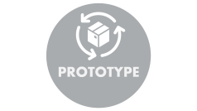

DESIGN THINKING
IS NOT JUST TO PRODUCE DESIGNS BUT IT HELPS IN BEING INNOVATIVE.
IN THIS REPORT, WE WALK THROUGH THE IDEATION INTO A PROTOTYPE AND TESTING JOURNEY TO
ADDRESS REAL-WORLD PROBLEMS.

Slide 2

EMPATHIZE

Slide 3



EMPATHIZE
First, during this phase the emphasis is placed on understanding what needs and aspects users or stakeholders have, who you are offering a solution for.
Through interviews, observations , and surveys qualitative data is gathered.

Slide 4







DESIRABLE
HUMAN
FEASIBLE
INFORMATION
VIABLE
TECHNOLOGY
“ i know how you both feel”

Slide 5

DEFINE

Slide 6



DEFINE
During the "Define" phase of design thinking, our goal is to identify the central issue that needs to be tackled. This is preceded by the "Empathize" step, where we delve into people's needs and gain a deeper understanding. We then gather and analyse data to formulate a concise and well-defined problem statement. This critical step provides us with a clear direction to seek out solutions that effectively meet the challenges faced by users.

Slide 7

IDEATE

Slide 8




IDEATE
﻿This phase involves generating a extensive variety of innovative ideas to resolve the defined hassle.
It encourages brainstorming and ideation classes to discover diverse possibilities.

Slide 9


BRAINSTORMINGRULES
One Conversation at a time .
Go for Quantity .
Encourage wild ideas .
Defer Judgement-NO Blocking .
Headline!
Build on the ideas of Others .
Be Visual .
Stay on Topic .

Slide 10

PROTOTYPE

Slide 11
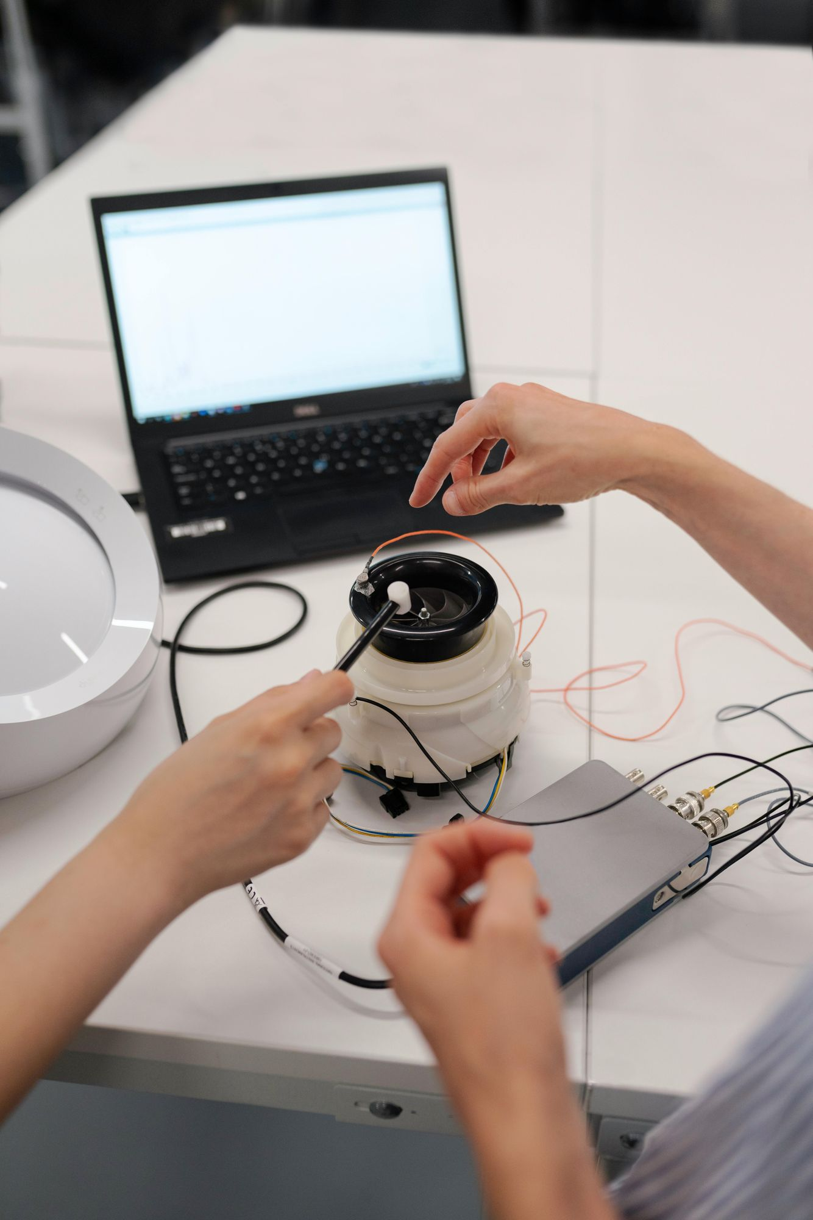

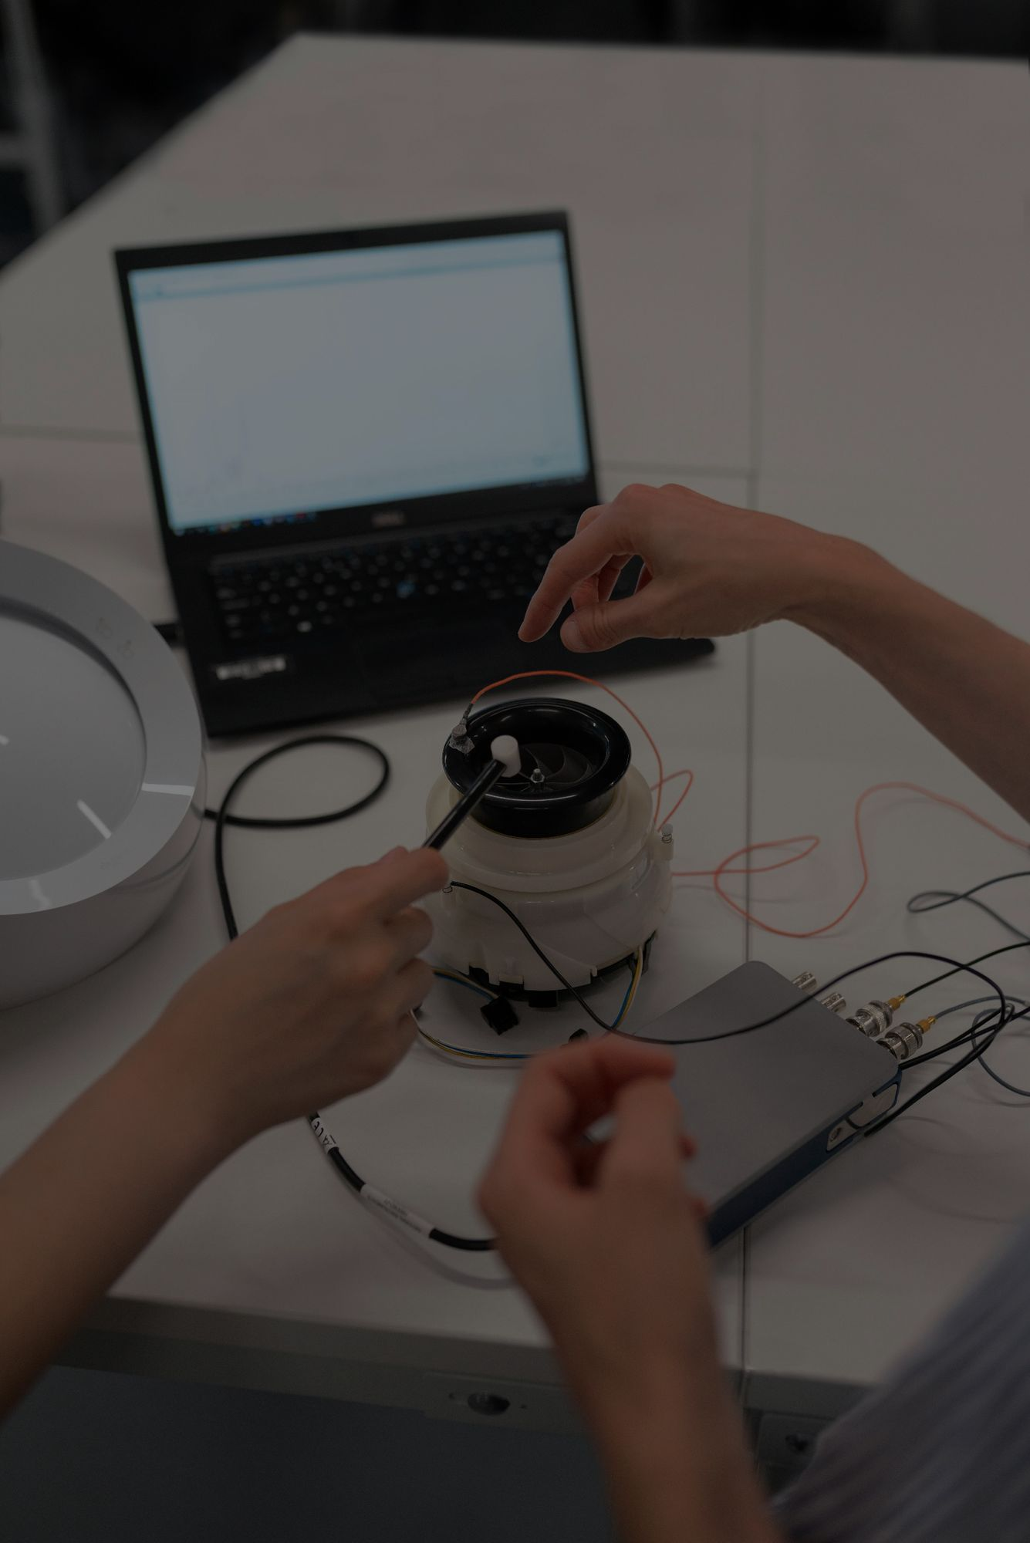
PROTOTYPE
In design thinking, during “Prototyping” phase it is about producing experimental versions of the ideas that are swift and straightforward to test them for improvement. There is a nine-step statistical process designed to work best when seeking user feedback to refine and enhance solutions before finalizing them.
This hands-on approach of a product development ensures the end ones satisfied users’ need effectively.

Slide 12






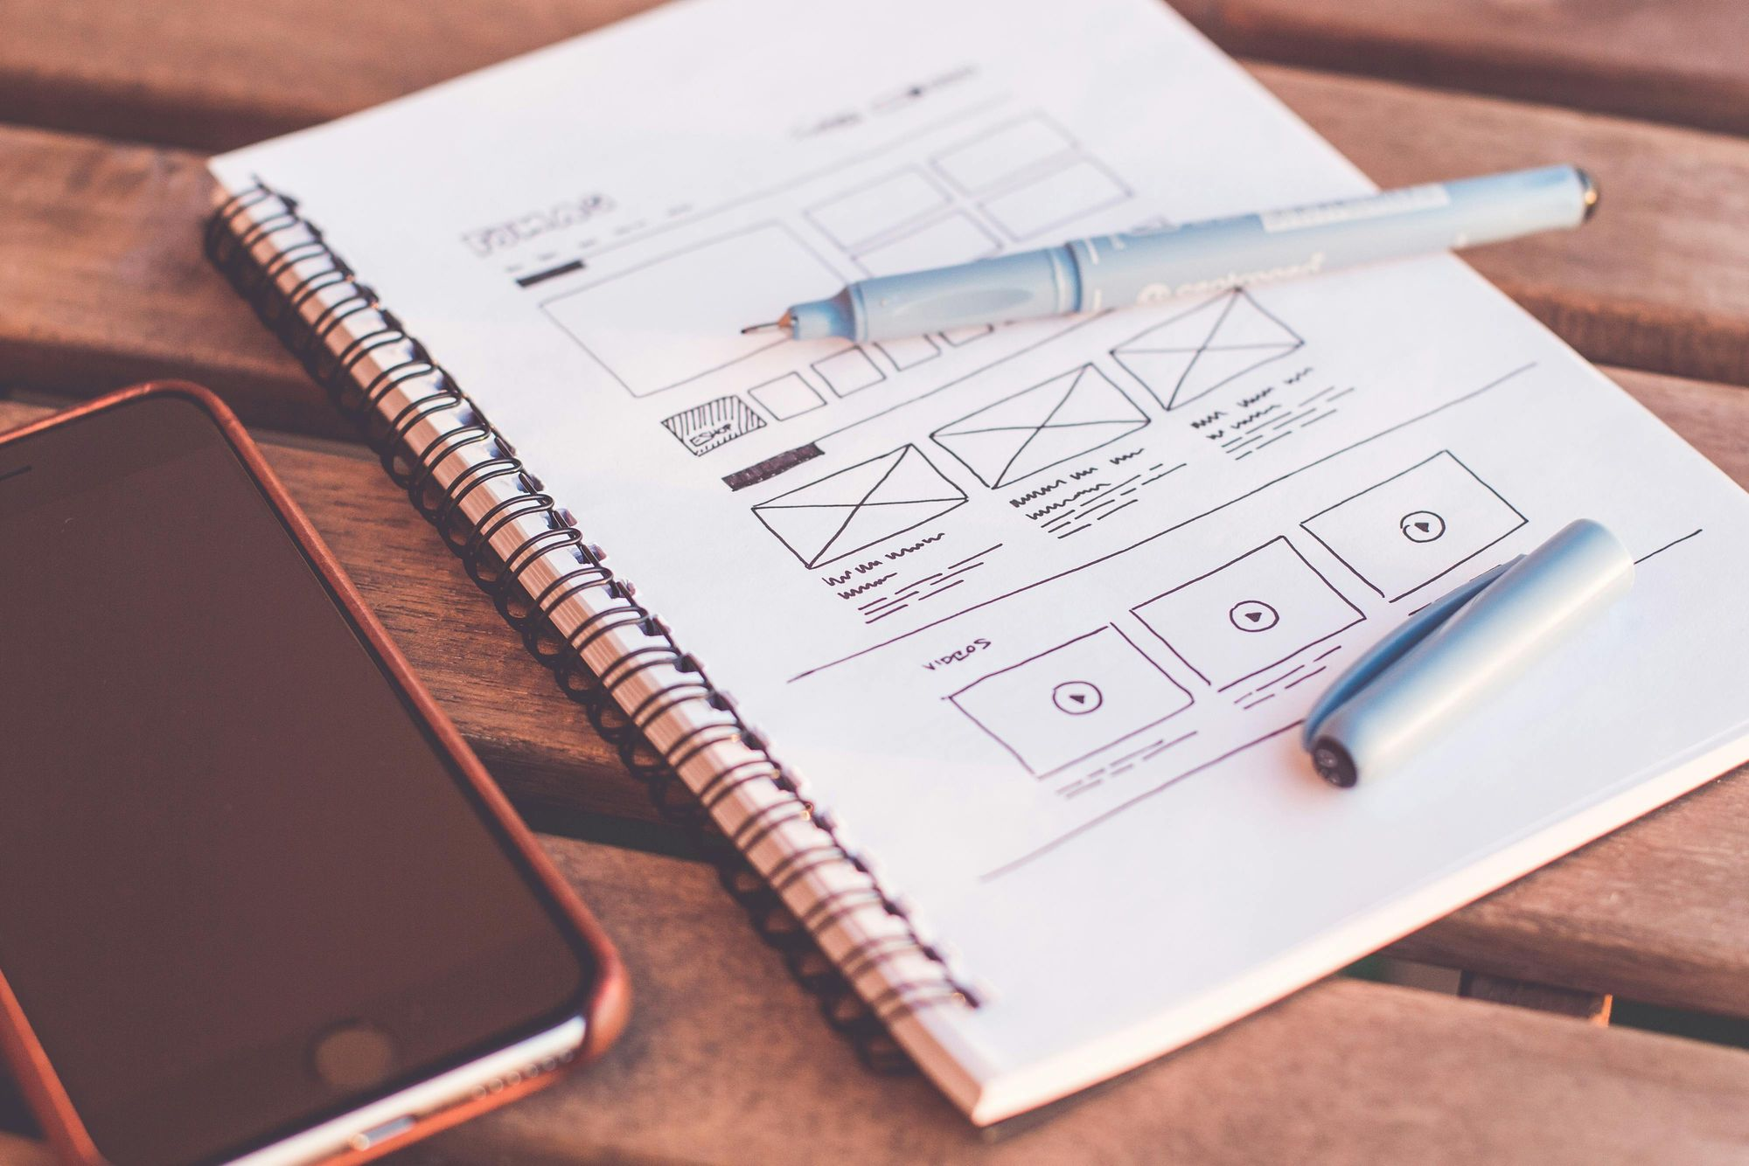
PROTOTYPES TOTEST
START BUILDING: Even if you aren’t sure what you’re doing, the act of picking up some materials (paper, markers, other objects are a good way to start!) will be enough to get you going.
BUILD WITH YOUR GROUP IN MIND: What do you hope to solve for the group? What sorts of questions do you expect? Answering these questions will help focus your idea/solution and help you receive meaningful feedback in the feedback phase.
LABEL YOUR POV: Identify what’s being solved for with your idea. It would be helpful to your audience if you wrote down and presented what need you are addressing (your POV statement).
TIPS FOR PITCHING & PRESENTATION
REVIEWS
TESTING
IDEA
PROTOTYPING
MAKE THE IDEA
TANGIBLE

Slide 13

TEST

Slide 14



TEST
During the “Testing” stage of design thinking, users test prototypes. So, feedback is gathered to fine-tune and enhance solutions before implementation. Making sure the final product meets user needs effectively is tested.

Slide 15

THANK YOU!

